Slide 1
Bluemix Stand and Deliver/Demo October 2016
Michele Jordan

Slide 2
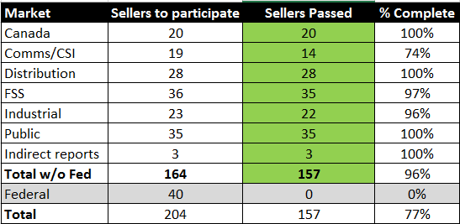
Bluemix Stand and Deliver Demo Program
Hybrid Cloud Portfolio Sellers (due Sept 23)
164* Hybrid Cloud Sellers / 157 completions
96% completion rate
40 Federal sellers * scheduled for 10/13 Herndon
Hybrid Cloud FLMs
26* FLMS / 26 completions
100% completion rate
5 Federal FLMs* scheduled 10/13 - Herndon
Results as of 9/29

Slide 3
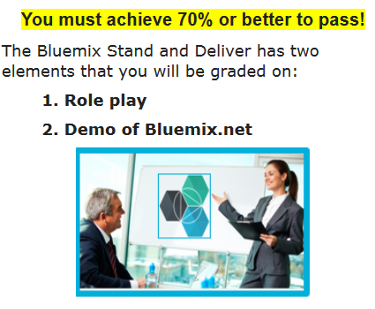
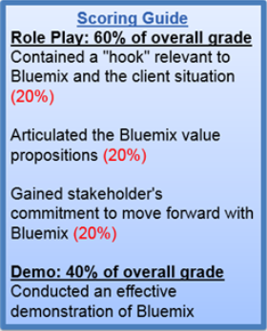
Get ready to Stand and Deliver/Demo
Prepare for your 15-20 minute Bluemix role play and demo
Listen to the replay of Stand and Deliver program
Download the 1-pager Bluemix Stand and Deliver Cheatsheet
Check out these videos on how to demo
Short Bluemix Overview
How-to Use Bluemix
Deploy Node-RED on Bluemix
Use Bluemix DevOps
MQA - "your mobile app is terrible"
Make sure you have a Bluemix account, sign up here if you don’t.
Successfully present your Bluemix Stand and Deliver/Demo on Oct 13 at IBM Herndon
Recommended timing:
3-5 minutes to provide context of role play scenario
10 minutes for role play exercise - be sure to meet all 3 requirements of above Element 1 Scoring Guide
10 minutes to demonstrate the value of Bluemix via Bluemix.net
Note: the demo is not expected to be part of the role play conversation. But for those who thrive on overachieving you could incorporate the demo into your role play!
7-10 minutes for coaching/feedback
More details

Slide 4
Federal Bluemix Day Agenda Oct 13 – IBM Herndon 9am – 5pm
Draft Agenda
Subject to change
Topic | Presenter / SME
Opening Remarks | Bryna Dash / Liz Martin
Bluemix enablement – Federal use cases | Michael Bussey Greg Pollack
FLM Stand and Deliver | Janet Butler, Aki Duvvur, Michael Bussey, Chris Dejten, Frank Parra
Seller practice session- refine your pitch/demo | Andrew Mazen Greg Pollack Paul Horan
Lunch
*Seller Stand and Deliver Demo each rep has a 30 minute slot | FLM, with assist from SMEs
*Seller Stand and Deliver Demo Each rep has a 30 minute slot | FLM, with assist from SMEs
*Stand and Deliver schedule will be sent Monday Oct 10
*Stand and Deliver schedule will be sent Monday Oct 10

